Slide 1


Universal Weapon System

Slide 2

What is the Universal Weapon System
The System provides players with missions that offer points to buy weapons of all kind.
From pistols to galactic spaceships.

Slide 3
FEATURES
A UI to display skills, status and weapon descriptions
Mission
Events
Point system
Authority
Upgrade
An in-built store offering weapons across the universe

Slide 4

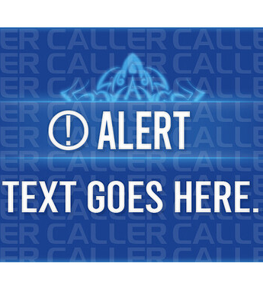
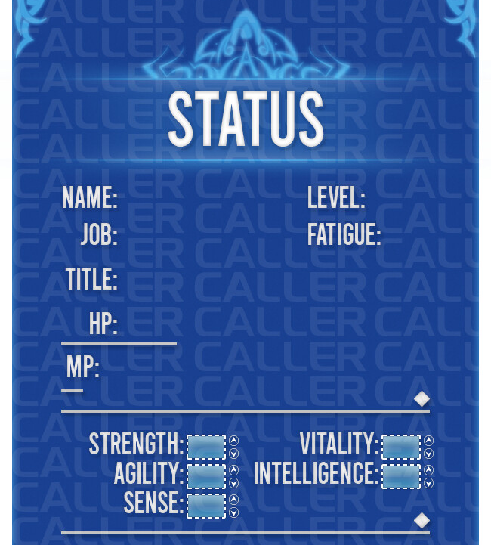
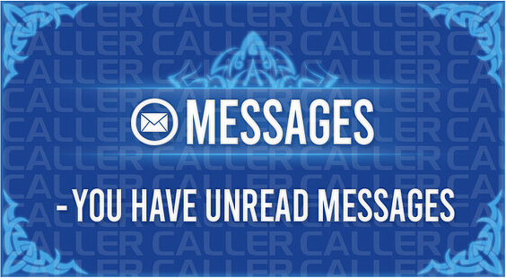
UI

Slide 5
Missions
assault: infiltrate enemy bases and destroy them.
rescue: save hostages from enemy territory.
exploration: discover new planets and secrets.
sabotage: infiltrate and sabotage enemy operations.
diplomacy: negotiate alliances or treaties for strategic advantage.

Slide 6
Events
alien invasion: defend earth from alien attackers in escalating battles.
temporal anomaly: navigate through time rifts, stabilize them, and prevent disasters.
bounty hunting: pursue criminals across the galaxy for rewards.
artifact retrieval: find ancient artifacts for powerful rewards.
galactic war: join factions in large-scale battles for control.
players can participate in challenges and events to earn bonus points, authority points, and exclusive rewards.
challenges may include defeating powerful enemies, completing missions within a time limit, or achieving specific objectives.

Slide 7
Point System
Each weapon is assigned a point value based on its rarity, power, and technology level.
Players earn points by completing missions, defeating enemies, and achieving objectives.
Points can be used to purchase weapons, upgrade existing weapons, and unlock new abilities or perks.
point value ratio:
modern weapons ratio: futuristic weapons ratio = 1:10
futuristic weapons ratio: space weapons ratio = 1:10
space weapons ratio: cosmic annihilators ratio = 1:100

Slide 8
Authority
Authority levels are divided into tiers, such as basic, intermediate, advanced, elite and legendary
Players must earn authority points to advance to higher tiers.
Higher authority levels grant access to more powerful and rare weapons.
Authority points are earned by completing missions, gaining experience, and achieving specific goals within the game.

Slide 9
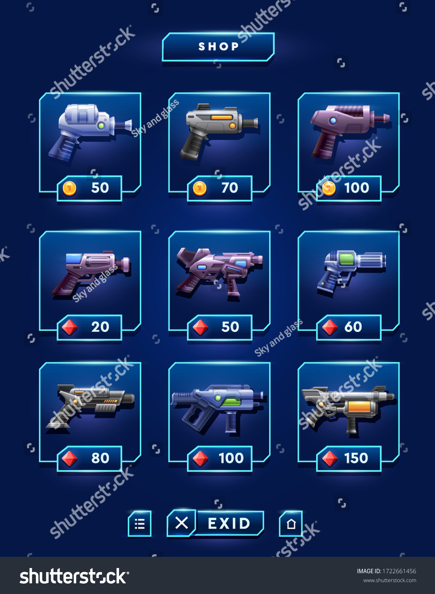
Weapon Store
The weapons store offers a variety of weapons categorized into different tiers based on their rarity and power.
Players can purchase weapons using points earned in-game.
Higher-tier weapons are locked until the player reaches the corresponding authority level.
Something as simple as this image. Hovering your cursor over a weapon should pop up a bubble that displays descriptions of the weapon.
If player don’t have the corresponding authority, they can’t view the descriptions of the weapon, only the name, image and cost.
Search option below where players can search key words of weapons.

Slide 10
Upgrade
Weapon Upgrades:
Improve weapon damage, accuracy, and other attributes.
Unlock attachments like scopes and grips.
Armor Enhancements:
Strengthen defense and unlock special abilities.
Skill Tree Advancements:
Invest points to unlock new abilities and passive bonuses.
Ship Modifications:
Upgrade ship systems for better performance and weaponry.
Augmentations and Implants:
Gain unique abilities through cybernetic enhancements.
Research and Development:
Discover new upgrades by researching artifacts and resources.
Cosmetic Customization:
Customize appearance with skins, paint jobs, and accessories.

Slide 11
Design Intention
Universal Weapon System is a powerful tool to aid and make players the god of war. The Gameplay that a player can achieve while using its weapons can change the very thing, we call history
The U.W.S (Universal Weapon System for short) is a holographic user interface that’s dynamic enough to respond in real time, by disappearing from players view when they get into combat. The weapons in its store can cause a devastating destruction once they appear.
It gives the players a feedback feeling of being a skilled warrior battling against formidable foes.

Slide 12
Priority & Scope
Art: 15 months (High)
UI/UX Design: 12 months (High)
Audio: 10 months (Medium)
Programming and Scripting: 10-12 months (Medium)
Environment Design: 8 months (Medium)
Upgrade: 6 months (Low)
VFX: 6 months (Low)

Slide 13
Dependencies
Art: Character models, weapon designs, cosmetics assets, and UI elements including the weapon store interface.
Animation: Combat animations, enemy movements, cinematic sequences, and UI animations for the weapon store.
Audio: Sound effects, voice-over recordings, music tracks, and dynamic audio systems for the game and weapon store.
Combat: Game mechanics, enemy AI behavior, weapon balancing, and combat feedback systems.
Game Design: Overall vision, core gameplay mechanics, progression systems, mission objectives, and the design of the weapon store interface.
Level Design: Environment layouts, storytelling elements, gameplay flow, scripted events, and integration with the game world.
VFX: Visual effects for combat, abilities, UI elements including the weapon store interface, and post-processing effects.

